Slide 1
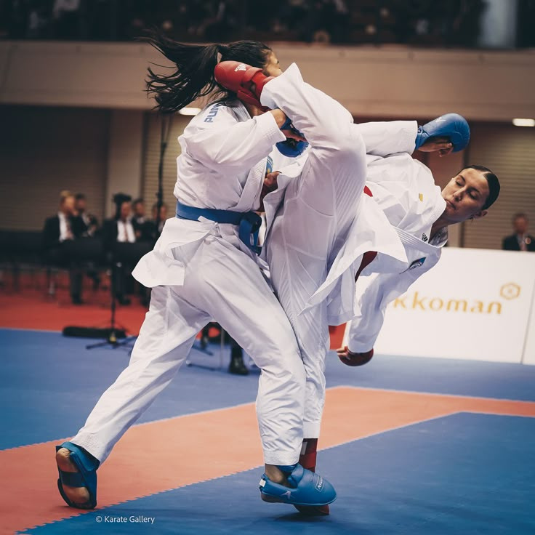
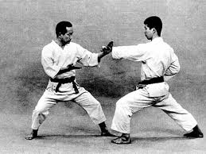


KARATE : A WAY OF LIFE

Slide 2
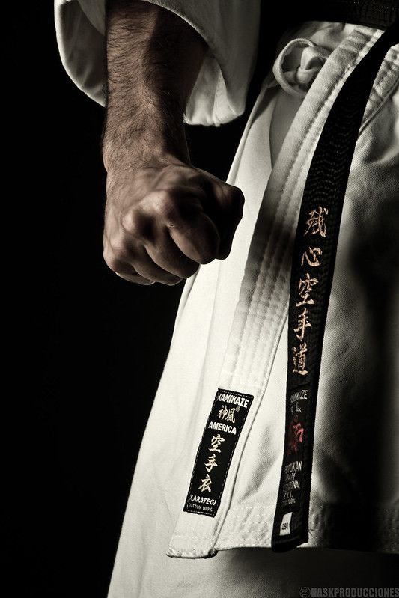

WHAT IS KARATE ?
The Art Of Empty Hand
Using the body as a weapon without any arms.
A Defensive System
The science of responding to an attack.
A Life Philosophy
It teaches respect, honor, discipline and constant self improvement.

Slide 3
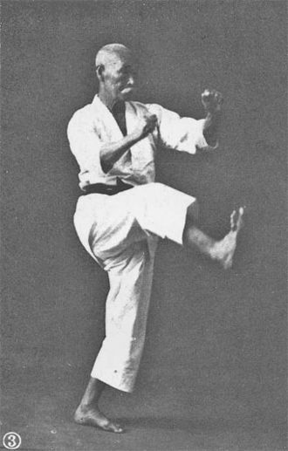
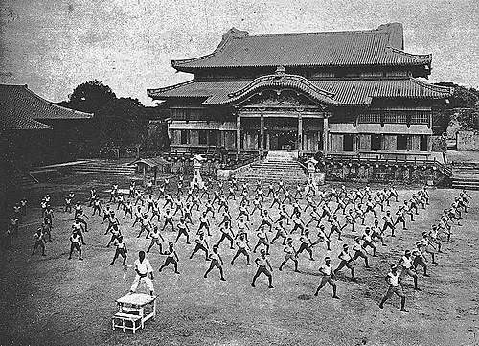
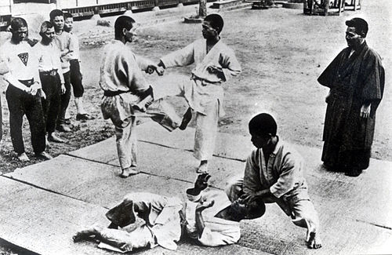

ORIGIN AND HISTORY
Origin
The island of Okinawa, Japan.
Development
A blend of traditional Japanese martial arts and native Okinawan fighting styles.
Global Spread
Spread worldwide from Japan in the 20th century.
Chōmo Hanashiro
an Okinawan karate master c. 1938
Karate training in front of Shuri Castle in Naha (1938)
Karate in Naha before the war (before 1946)

Slide 4
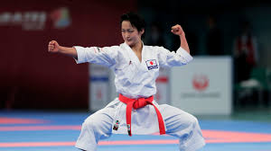

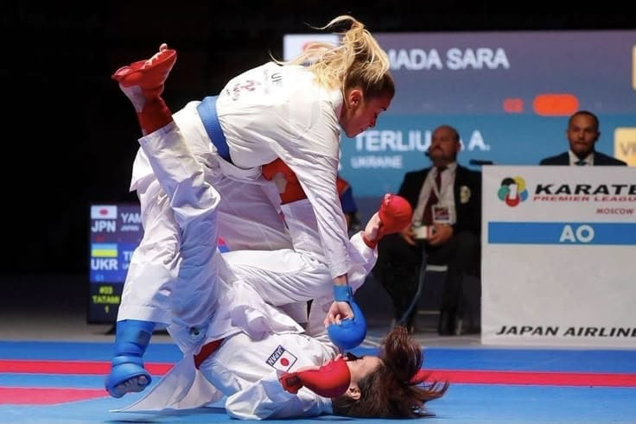
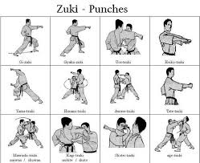

Kihon (Basics)
Drilling stances, strikes, and blocks.
Kata (Forms)
A pre-arranged sequence of offensive and defensive techniques. Often called a "imaginary fight".
Kumite (Sparring)
Practicing with a partner in a controlled environment.
THE HEART OF KARATE

Slide 5
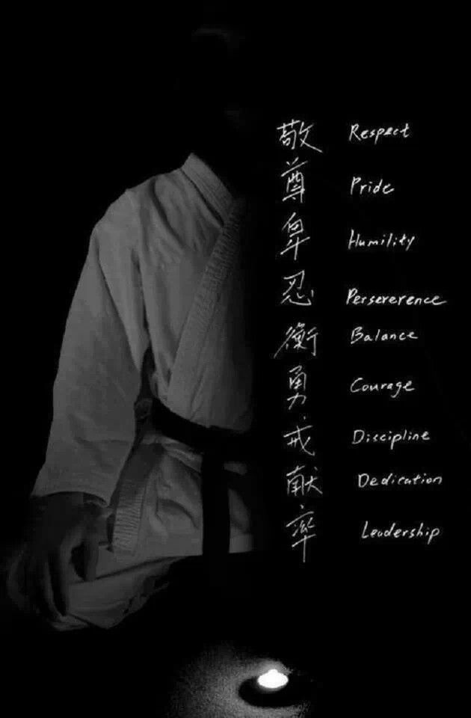
WHAT YOU GAIN
Tangible
Physical safety and self-confidence.
A stronger body, better coordination, and reflexes.
Intangible
Mental fortitude, focus, and ambition.
Respect, discipline, and good character.

Slide 6
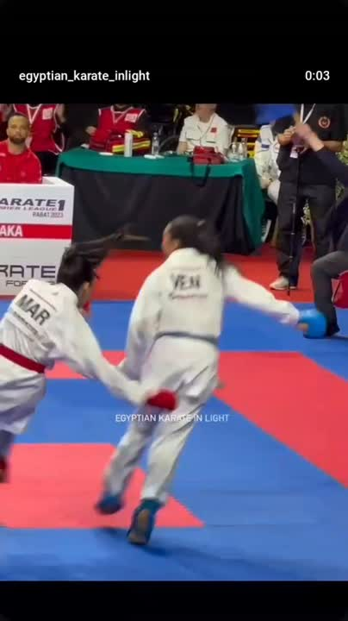
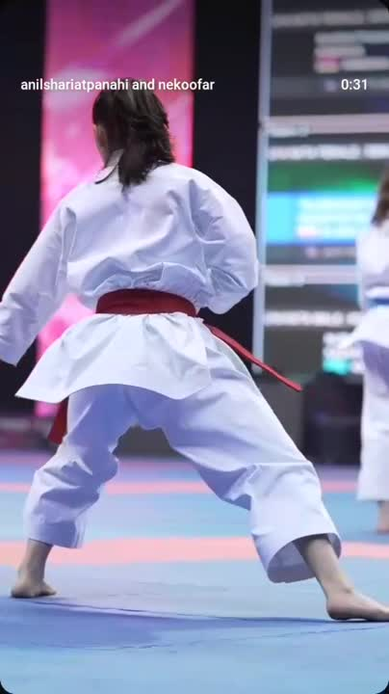
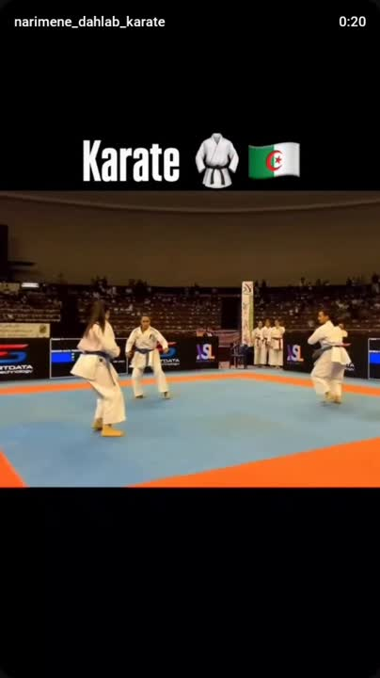

Slide 7
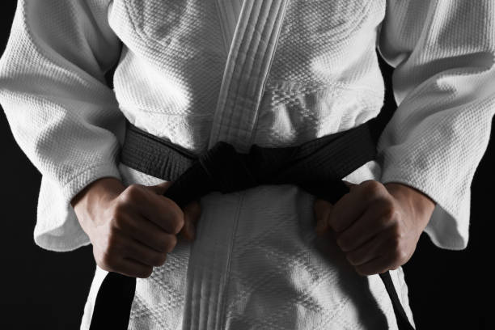
THANK YOU

